Slide 1

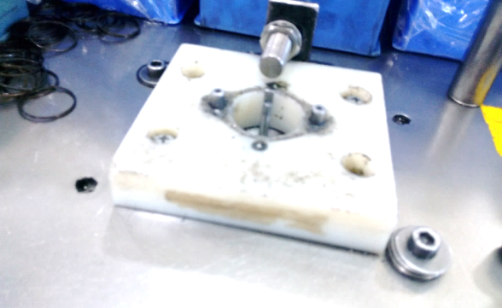
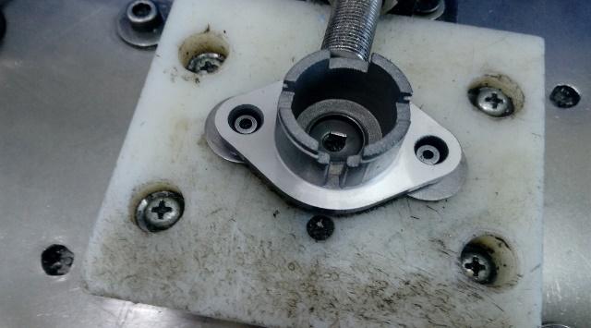
P15
TPM CIRCLE NO :- 01
ACTIVITY
KK
QM
PM
JH
SHE
OT
DM
E&T
KAIZEN IDEA SHEET
TPM CIRCLE NAME: Achiever
LOSS NO. / STEP
DEPT :- Assembly
RESULT AREA
P
Q
A
B
C
D
S
M
CELL : Spring annea
CELL NAME: Tensioner
MACHINE / STAGE : Winding
OPERATION : Spring Winding
KAIZEN THEME : To improve production at A319 tensioner .
IDEA : A319 /A267 Tensioner Assembly Setting on Same Fixture
PROBLEM PRESENT STATUS: Separate line set for A267 Tensioner Assembly but production plan is low so line stop 7 hrs/shift
COUNTERMEASURE:- A267 tensioner job assembly on A319 winding fixture at that time insert washer for maintain pin height
BENCHMARK
TARGET
KAIZEN START
TDC
KAIZEN FINISH
TEAM MEMBERS: Surekha Choudhari,
Samadhan Bankar , Surkha Kokane
BENEFITS :- Improve productivity ,
Reduce sat up time
Before
After
KAIZEN SUSTENANCE
WHY - WHY ANALYSIS :-
Why1 : A267 tensioner height is less as compare to A319 tensioner
Why2: Required pin height set by allen kay
Why3: Separate line arrange st A267 tensioner
Why4: A267 tensioner production plan is less so line stop 7 hrs in per shift time .
RESULT :-
WHAT TO DO:-
HOW TO DO:
FREQUENCY :-
SCOPE & PLAN FOR HORIZONTAL DEPLOYMENT
Sr No | CELL | TDC | RESP. | STATUS
1
2
ROOT CAUSE : Line Stop 7 hrs in Per shift
REGISTRATION NO. & DATE: 4.1.2017
REGISTERED BY: Surekha choudhari
MANAGER’S SIGN :- Janardhan sathe

